Slide 1
NLP - Natural Language Processing

Slide 2







About me
Rafal Pronko
data scientist / machine learning enthusiast
rafalpronko
http://piazza.com/nlprafalpronko/spring2018/nlp101
Access code: nlp101

Slide 3
Agenda
Presentation part:
Business problem
Data sources
Tools
Workshops:
NLP - introduction
Spark - introduction
Basic NLP@Spark
Basic ML@Spark

Slide 4
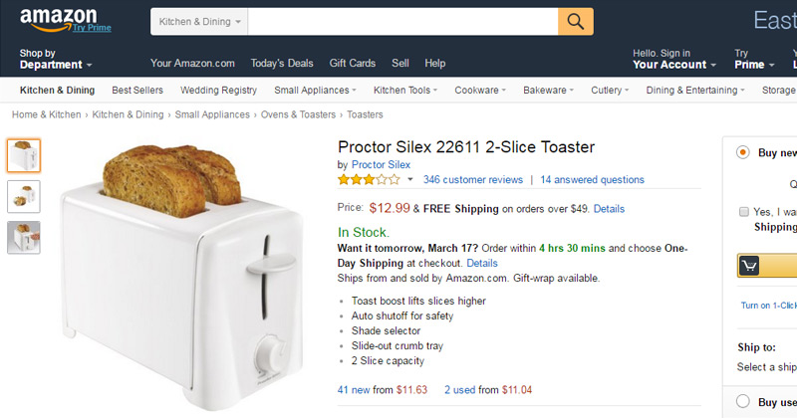
Business problem

Slide 5
Data sources
R. He, J. McAuley. Modeling the visual evolution of fashion trends with one-class collaborative filtering. WWW, 2016
J. McAuley, C. Targett, J. Shi, A. van den Hengel. Image-based recommendations on styles and substitutes. SIGIR, 2015

Slide 6

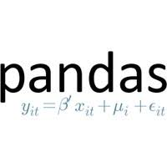




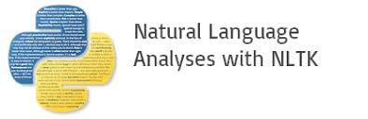
Tools url.getindata.com/text-mining

Slide 7
NLP - short introduction
Natural-language processing (NLP) is a field of computer science, artificial intelligence concerned with the interactions between computers and human (natural) languages, and, in particular, concerned with programming computers to fruitfully process large natural language data.
Challenges in natural-language processing frequently involve speech recognition, natural-language understanding, and natural-language generation.

Slide 8
NLP - short introduction - key application areas
Automatic summarizer
Sentiment analysis
Text classification
Information extraction

Slide 9
Notebooks introduction
Block of texts
Code to run (import pandas as pd)
Short exercises to do (# TODO - show how many items left)
Biggest exercises to do
Bonuses

